Slide 1

Towards a responsible expertise
Workshop4 Group3
Hang Su, Yifan Zhou, Puxi Cao, Chenhao Zhang, and Han Zhang

Slide 2
The performance order
How systems thinking can be used for transdisciplinarity? -Hang Su
What's collective thinking, reflective thinking, wicked problems? -Yifan Zhou
How to move from disciplinarity to transdisciplinarity? -Puxi Cao
What are the relevant concepts and methods for undertaking a transdisciplinary research? -Chenhao Zhang
How expert's expertise could be ethical and responsible? -Han Zhang

Slide 3
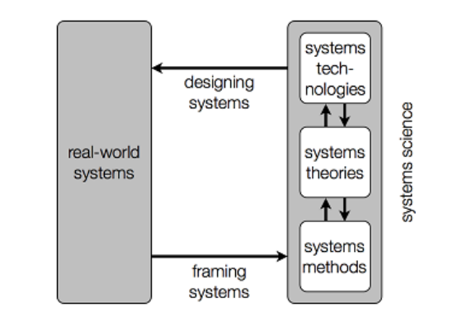
System thinking is best suited for transdisciplinary studies
Modelling Systems

Slide 4
Disciplines and Transdisciplinarity
Aims: problems
Scope: a piece of reality
Tools: generalisations
Aims: complex problems
Scope: a bigger picture of reality
Tools: similarities across disciplines

Slide 5

The systems way of thinking: integrativism
Universalism
Particularism

Slide 6
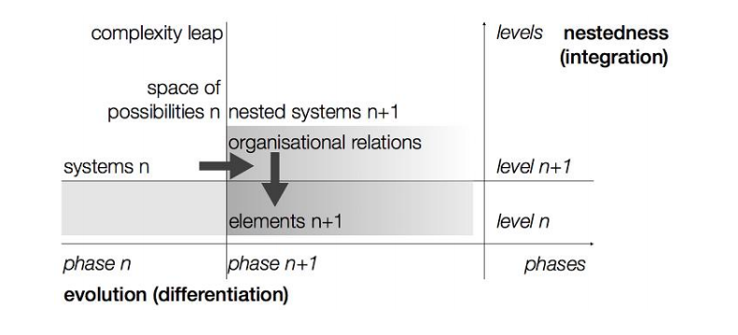
The systems world picture: the multi-stage model of evolutionary systems
The multi-stage model of evolutionary systems

Slide 7

The systems world view: Synergy
Meaningful technology is oriented towards the advancement of synergy and hence alleviation of frictions.

Slide 8
Collective Thinking
Significance
Effective way to obtain comprehensive understanding of complex social-environmental issues.
Can help us to overcome the barriers between the traditional knowledge
Methodology
Welcome diversity
Treating opposite as interdependent relations
Follow the principle of deep democracy
Applying different knowledge collectively

Slide 9
Reflective Thinking
General Methodology
Observe and analyze based on the acquired experience dynamically and interactively
Making judgements and plans based on the results of observe and analyze.
Kolb’s Leaning circle (One example)
Concrete experience (having a new experience)
Reflective observation (reflecting on that experience)
Abstract conceptualization (learning from that experience)
Abstract experimentation (apply what you’ve learned from that experience).

Slide 10
Wicked Problem
Features
Has many independent factors and a complex system is involved
Hard to find balanced solutions
Example:
The urbanization process in China:
Stakeholders:
1. Government
2. Land agents
3. Manufacturing industrial entrepreneurs
4. The farmers
5. The urban middle and low incomes

Slide 11
Review of Transdisciplinarity
‘Transdisciplinarity requires deconstruction, which accepts that an object can pertain to different levels of reality, with attendant contradictions, paradoxes, and 14 conflicts’
(Klein, 2004)
‘It does, in effect, require a completely different framework of working, unrecognizable to disciplinary organizations or their specific research methods’
(Wilby, 2011)

Slide 12
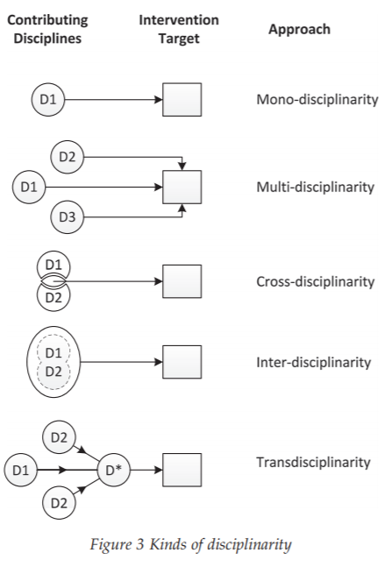
Review of Transdisciplinarity
Multi-disciplinarity:
making use of several disciplines at once, acknowledging their different approaches but without attempting to bridge between them
Cross-disciplinarity:
coordinated effort involving two or more academic disciplines, trying to establish a kind of middle ground
Interdisciplinarity:
the process of combining two or more disciplines or fields of study, attempting to synthesize them into something new

Slide 13


Inspiration 1
Move from disciplinarity to transdisciplinarity is about:
Firstly, establishing a new framework.
Secondly, use the framework to integrate knowledges needed from different traditional disciplines.
Meanwhile, the framework should satisfy system principles of traditional disciplines and the new discipline.

Slide 14
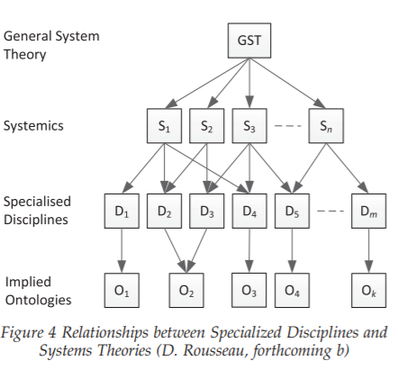
General System Theory (GST) – Unity of Knowledge
GST encapsulates the principles that recur across the Systemics, and hence represents the most general principles behind the kinds of order we find in the concrete world (Von Bertalanffy, 1950).
Different disciplines can share similar ontologies.
Different disciplines can be connected by systems.
GST is the largest system connects everything.

Slide 15

General System Ontology (GSO) - Unity of Nature
(Laszlo, 1972)
Firstly, the existence of specialized disciplines shows that the concrete world is organized into domains.
Secondly, systemics, by revealing principles occuring across domains, show the concrete world is organized as a whole. Meanwhile, this global organization is reflected by GST.
Thirdly, the existence of global organizing principles entails that the concrete world’s special domains are contingent expressions of a unified underlying ordered reality.
1. there is an ordered reality underlying Nature which was characterized as General Systems Ontology(GSO).
2. GST provides a formal model of some of the essential characteristics of this concrete Ultimate Reality.

Slide 16
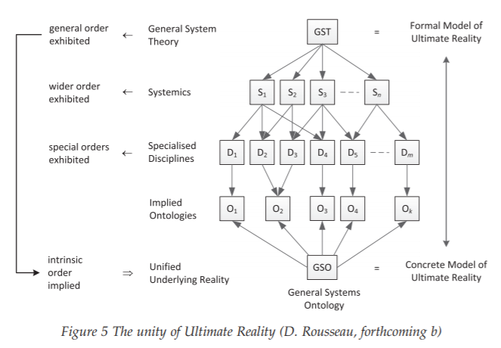
Inspiration 2
As the individual disciplines advance their ontological implications, they will increasingly become consistent with GSO.
In the long run, the ontological implications of the specialized disciplines cannot sustain mutually inconsistent claims about the nature of GSO.
The ontological pluralism at present across disciplines is merely an empirical phenomenon, reflecting multiple partial perspectives on a deeper ontological monism that is richer than current ontological models

Slide 17

How to move from Disciplinarity to Transdisciplinarity
1. an overarching and unifying GST;
2. an underlying Systems Philosophy model reflecting the unified ultimate ontology (GSO);
3. a transdisciplinary language;
4. a non-reductive means of bridging the sciences and the humanities;
5. a worldview that reflects these systemic insights;
6. a methodology for using these models and insights to make new discoveries on the nature of the world, ourselves and our place in the scheme of things, and to support our ongoing evolutionary development.

Slide 18



Transdisciplinary desig in architecture
Transdisciplinary desig in AI
Transdisciplinary desig in human health
Concepts and Methods in Trandisciplinarity
Notes:
[1]
Fig1: Marg Hearn, The power of transdisciplinary design, https://architectureau.com/articles/essay-transdisciplinary-design/
Fig2: Bernard Marr, What Is The Importance Of Artificial Intelligence (AI), https://bernardmarr.com/what-is-the-importance-of-artificial-intelligence-ai/
Fig3: San Diego State University, Research Project: Excessive Body Weight and Ovarian Cancer, https://healthlink.sdsu.edu/research-project-body-weight-cancer/

Slide 19
Concepts and Methods in Trandisciplinarity
1. Reflectivity
2. TCI (Theme-Centered Interaction)
3. Co-producing
4. Integration

Slide 20
Concepts and Methods in Trandisciplinarity
1. Reflectivity
1)collaborative deliberation
2)social relevance
3)social experimentation
4)criticalness and transformation

Slide 21

Theme or purpose
Concepts and Methods in Trandisciplinarity
2. TCI (Theme-Centered-Interaction)
Application: definition of four scenarios for the city of Korneuburg
Specific interests and needs
Interaction
and
relations
Framework, environment, conditions and circumstances

Slide 22

Concepts and Methods in Trandisciplinarity
3. Co-producing
Inclusion
Collaboration
Integration
Reflexivity
Usability
Application: the Mistra Urban Futures programme in Gothenburg.

Slide 23
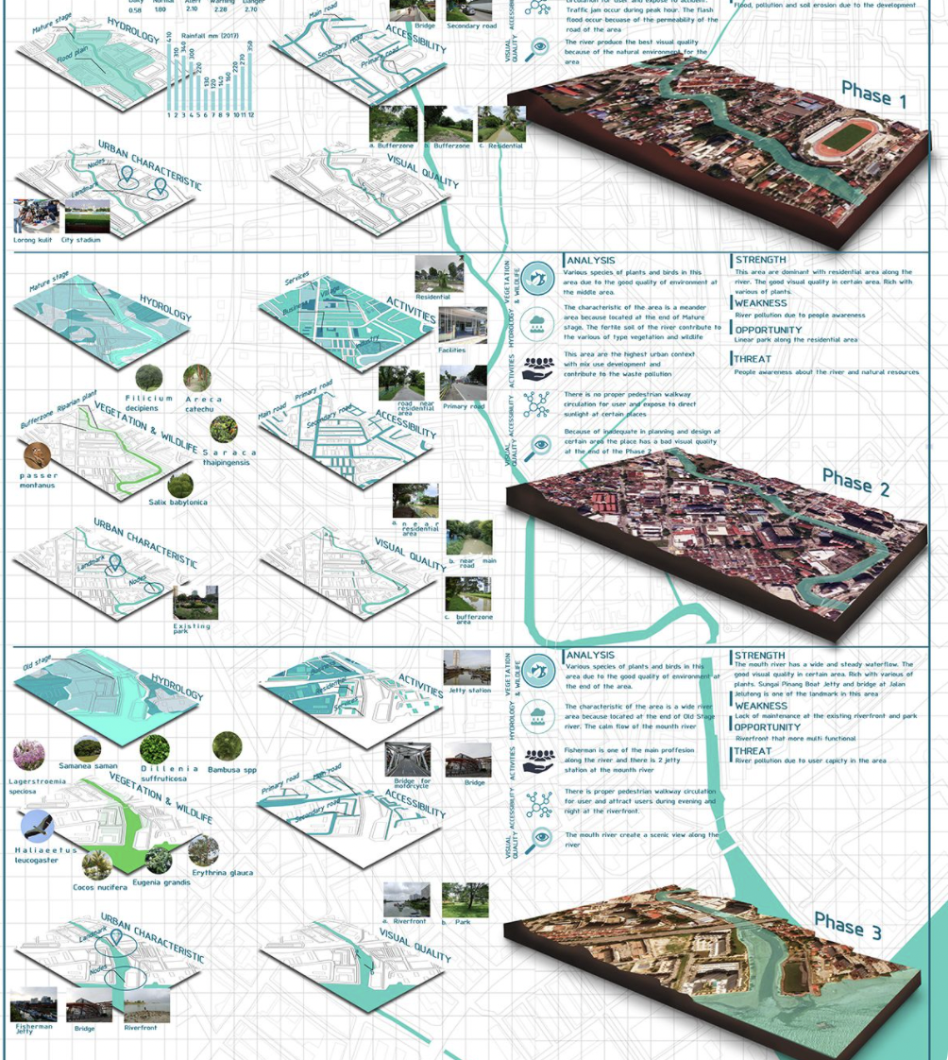
Concepts and Methods in Trandisciplinarity
4. Integration
An instrument that enables the description and structuring of the outcome of a specific research project
Application: Inventory of Synthesis in geology.

Slide 24

Take away messages
1. Always think of transdisciplinarity
2. Can you use TCI to analysis your project?
3. How to get outcome by using Co-producing?
4. How to integrate the knowledge?

Slide 25

How expert's expertise could be ethical and responsible?
Experts? Other people?
Notes:
Hi I am Han and I’ll talk about how expert's expertise could be ethical and responsible.
I think there are 2 major aspects, one is for the experts themselves, and the other one is for external factors.

Slide 26
For experts:
Be ethical in research
Be ethical in practice
Be responsible in innovation
Consider all the stakeholders
Beware of bias
Notes:
For experts themselves, the first important thing I think is that they should be ethical in research. Experts should always follow the Codes and Policies for Research Ethics, which can help ensure that they are responsible to the public in their research and avoid mistakes.
Also, experts should be ethical in practice. When facing ethical problems in practice, experts should make proper decisions even when under pressure, with the help of their expertise to understand the consequences of taking certain actions.
The third thing is that experts should consider the role in society of their innovations and be responsible to them. They usually know more about their inventions, so they should consider the social significance of the innovations and how they should be used.
To achieve the goals above, experts need to consider all the stakeholders involved when making decisions, especially the indirect stakeholders and those who are likely to be harmed, so they would not be harmed because of being ignored.
What’s more, experts should always beware of bias. They should not only do things that are beneficial to one party and leave the others in dilemma, or only talk about the strengths or weaknesses of one party when introducing the situation, even if it is true.

Slide 27
External factors:
Establish supervision and punishment systems
Protect experts from being disturbed
Treat the expert’s expertise as references
Notes:
In addition to the experts themselves, external factors will also affect whether they are ethical and responsible.
Like, unethical or irresponsible behaviors of experts should be investigated and punished, establishing systems of supervision and punishment can reduce these behaviors by enforcing them to undertake the consequences of their actions, thereby making them more careful about their words and actions.
In addition to this, experts should also be protected from being disturbed by other external factors, like reducing unreasonable repressive rules, or avoiding from being politicized. If experts are facing too much external pressure, they may do unethical things to protect themselves, or even use their expertise to do things harmful to the others.
The last thing is, for people who is making decision, taking the words of experts as reference rather than absolute truth will be helpful to identify the mistakes of experts and improve the correctness and rationality of the decisions. People should always have their own thinking.

Slide 28
Reference
Alvargonzález, D. (2011). Multidisciplinarity, interdisciplinarity, transdisciplinarity, and the sciences. International studies in the philosophy of science, 25, 387-403.
Bertalanffy, L.V. (2015). General System Theory: With a Foreword by Wolfgang Hofkirchner & David Rousseau. New York: George Braziller.
Branche, B. (2005). Reflective thinking. London: Athena Press.
Brown, V. and Lambert, J. (2013). Collective learning for transformational change. New York: Routledge.
Choi, B. C., & Pak, A. W. (2007). Multidisciplinarity, interdisciplinarity, and transdisciplinarity in health research, services, education and policy. Clinical and Investigative Medicine, 29, 351-364.
Cohn, R. TCI – Theme Centered Interaction. https://www.eppler-baden.ch/texte_he_e/tzi_e.htm
Douglas, H. (2008). The role of values in expert reasoning. Public Affairs Quarterly, 22(1), 1-18.
Hofkirchner, W. (2017). Transdisciplinarity needs systemism. Systems, 5(1), 15.
Laszlo, E. (1972). Introduction to systems philosophy: Toward a new paradigm of contemporary thought. New York: Routledge.
Li, B., Chen, C. and Hu, B. (2016). Governing urbanization and the New Urbanization Plan in China. Environment and Urbanization, 28, pp.515-534
MISTRA URBAN FUTURES. https://www.insideflows.org/project/mifra-urban-futures/
Muqri Jela. Site Inventory Analysis and Synthesis. https://www.pinterest.com/pin/770185973754980002/
Kerne, A. (2005). Doing interface ecology: the practice of metadisciplinary. In ACM SIGGRAPH 2005 Electronic Art and Animation Catalog, 181-185.
Klein, J. T. (2004). Prospects for transdisciplinarity. Futures, 36, 515-526.
Klein, J. T. (2010). A taxonomy of interdisciplinarity. The Oxford handbook of interdisciplinarity, 15, 15-30.
Resnik, B. D. (2020, December 23). What Is Ethics in Research & Why Is It Important? National institute of environmental health sciences. https://www.niehs.nih.gov/research/resources/bioethics/whatis/index.cfm
Ritchey, T. (2011). Wicked problems–social messes: Decision support modelling with morphological analysis. Springer Science & Business Media.
Rousseau, D., & Wilby, J. (2014). Moving from disciplinarity to transdisciplinarity in the service of thrivable systems. Systems Research and Behavioral Science, 31, 666-677.
Von Bertalanffy, L. (1950). An outline of general system theory. British Journal for the Philosophy of Science, 1, 134–165.

Slide 29

Thank you!
Notes:
Ok that’s all from me. Thank you for listening.

